Slide 1

Tensorflow Implementation of Normal Equation

Slide 2
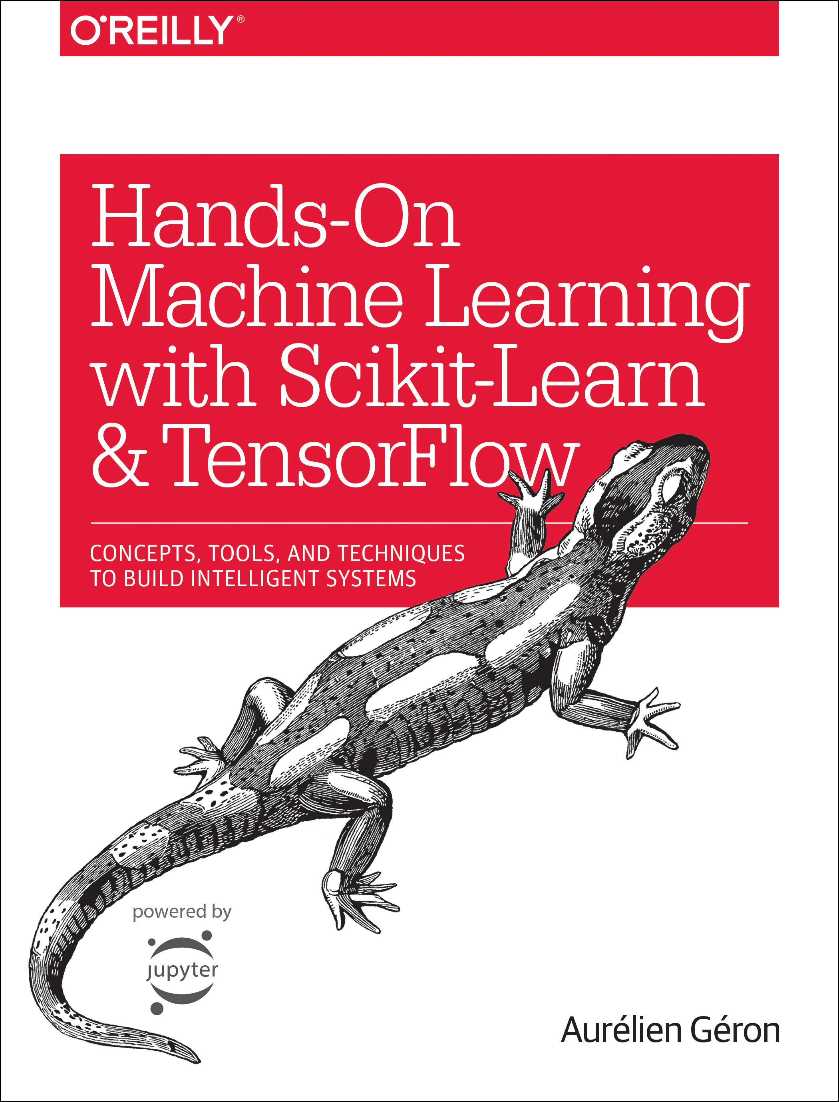
Reference
Chapter 9 (O'Reilly) of Hands-On ML
Youtube
Code

Slide 3
Data

Slide 4
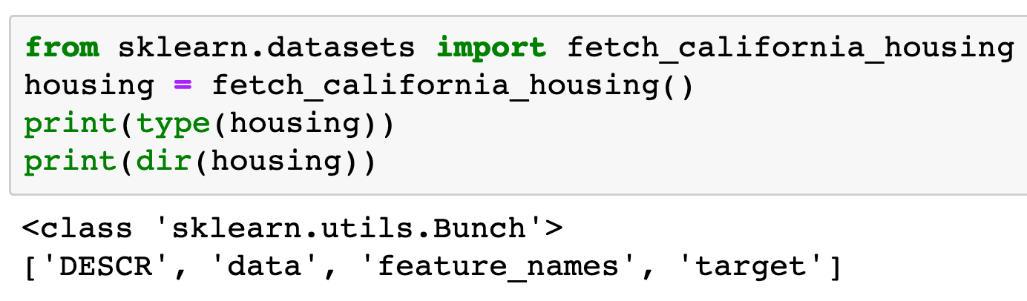

Slide 5
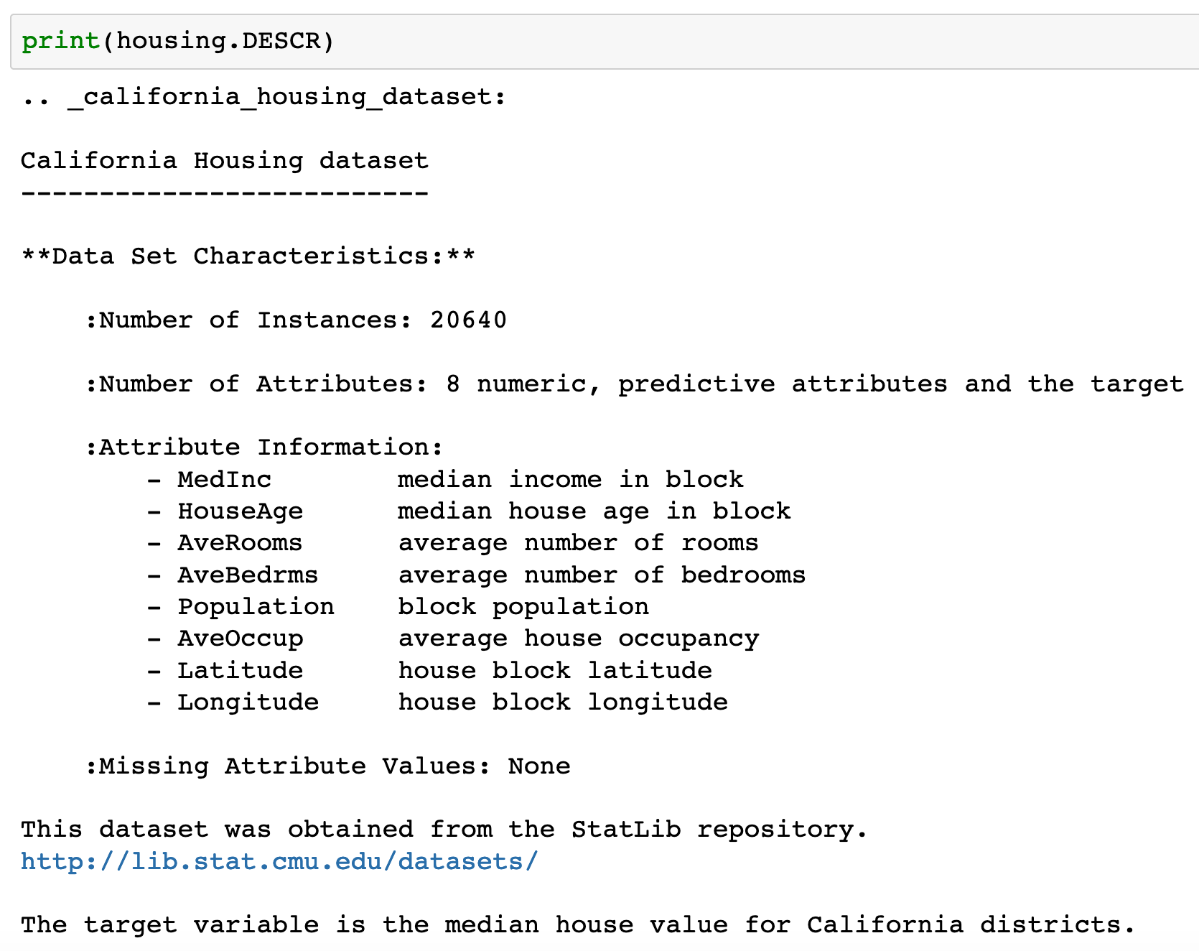

Slide 6
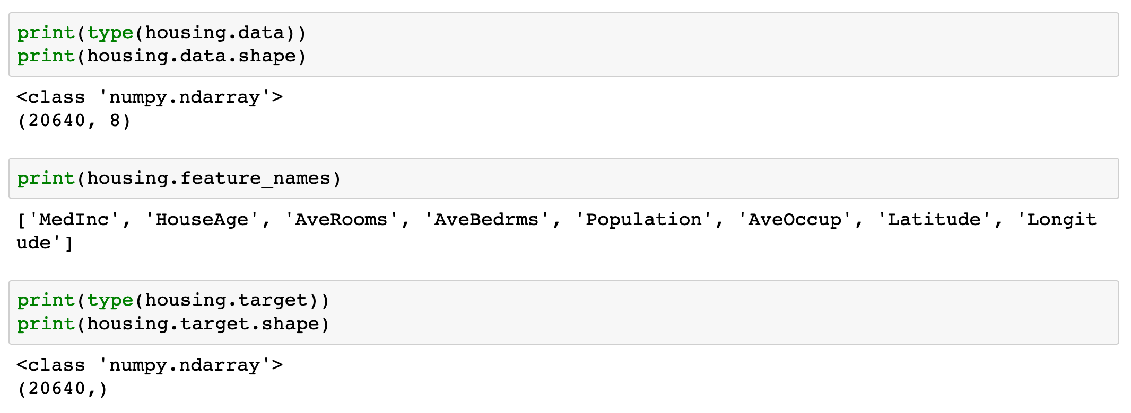

Slide 7
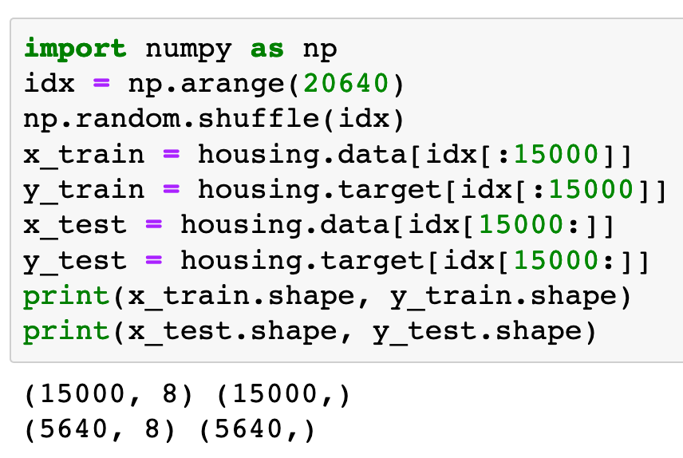

Slide 8
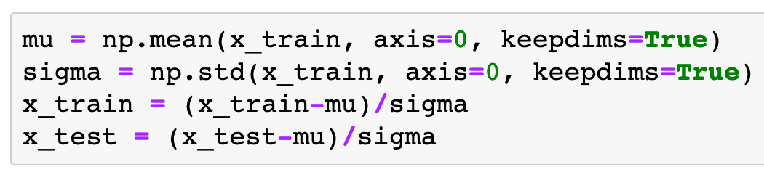
Input Normalization (Optional)

Slide 9
Warm Up

Slide 10
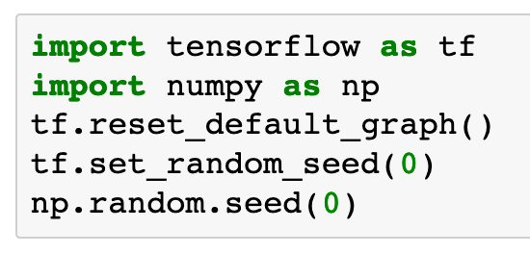

Slide 11
Graph

Slide 12
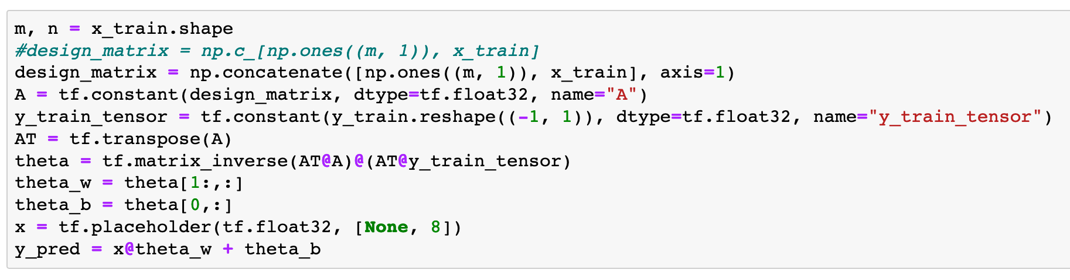

Slide 13
Session

Slide 14
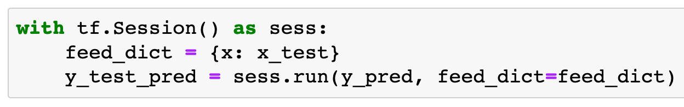

Slide 15
Report

Slide 16

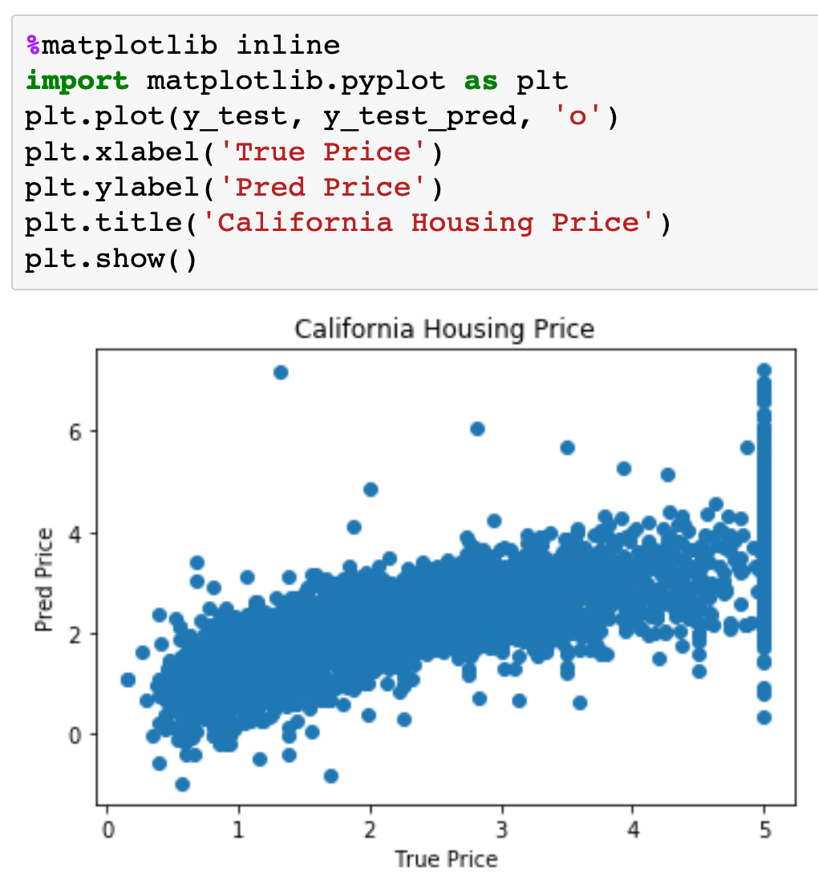
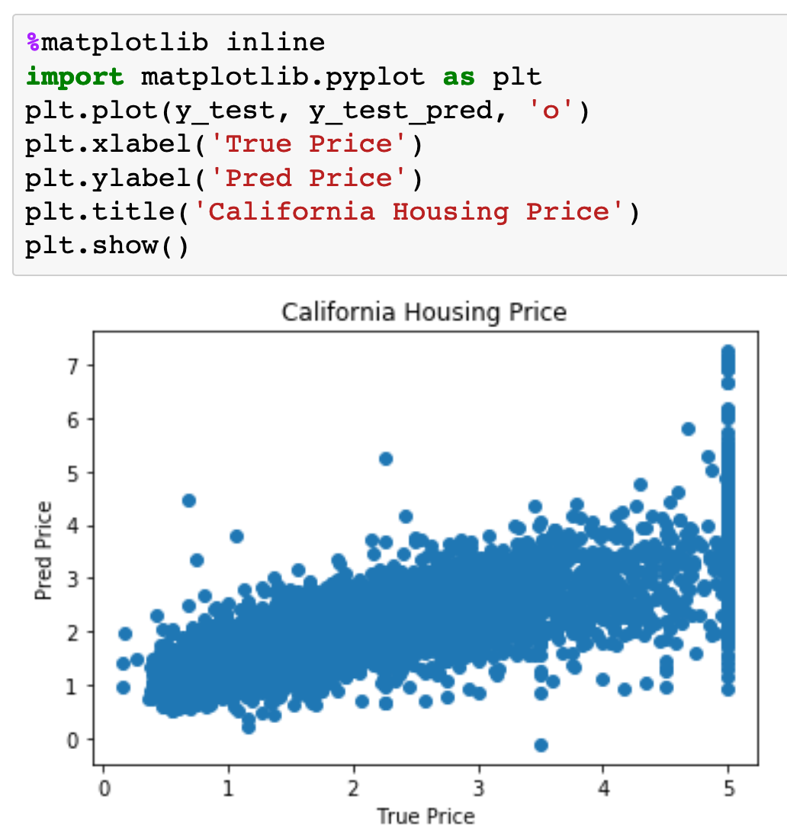
With Input Normalization
Without Input Normalization

Slide 17
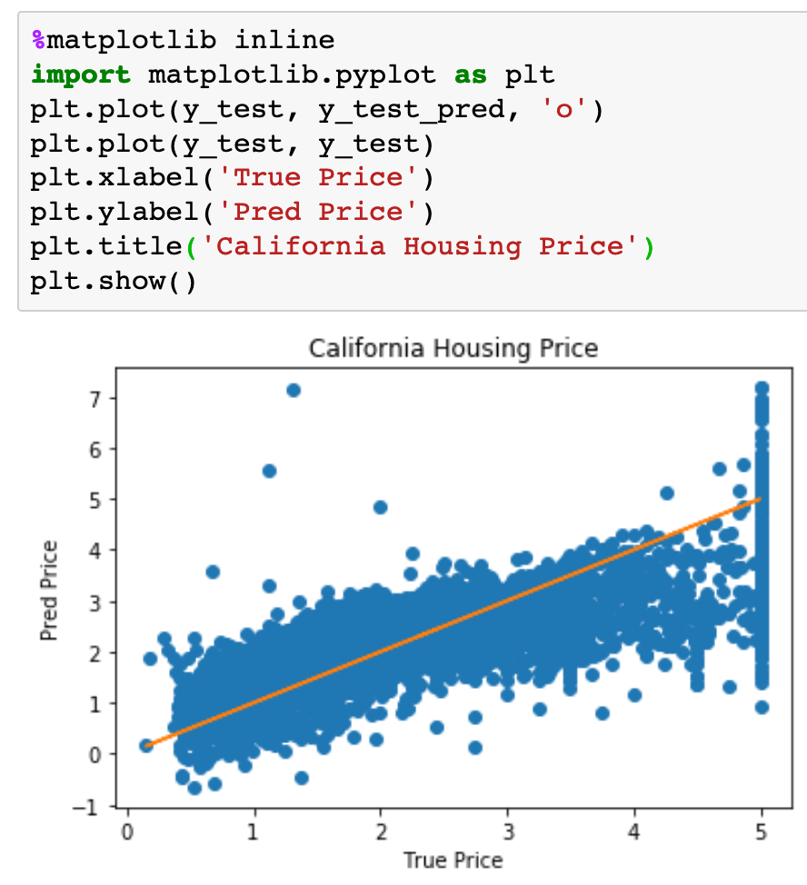
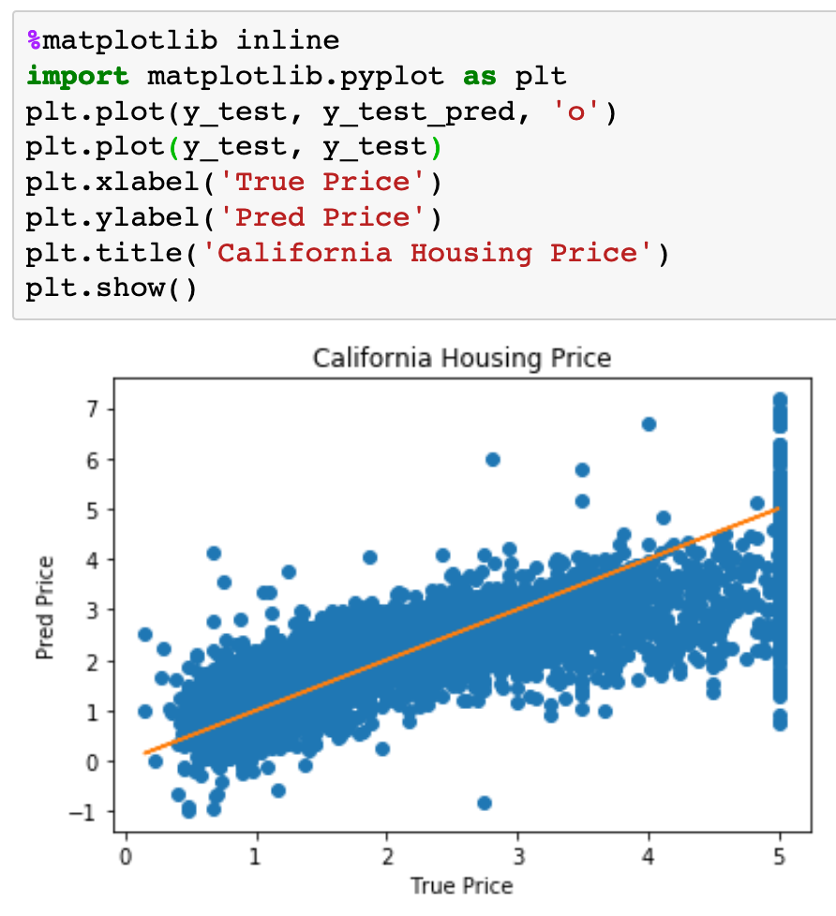
With Input Normalization
Without Input Normalization

Slide 18
With Input Normalization
Without Input Normalization

Slide 19
Now
Let’s Play with Code

